Slide 1
Post quantum crypto: BB84
17/7/2021

Slide 2
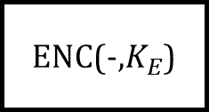

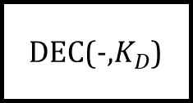
1. Intro
Symmetry
T
ENC
E
DEC
T
Old crypto
Alice
Bob
Asymmetry
T
ENC(-,$K_{E}$)
E
DEC(-,$K_{D}$)
T
Modern crypto: RSA
Alice
Bob
$K_{E}$ public

Slide 3

2. Problems
Shor algorithm has been solved $f\left(K_{E}\right)=K_{D}$ in poly time.
Solution: One – time pad protocol

Slide 4
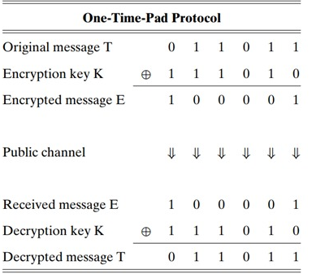
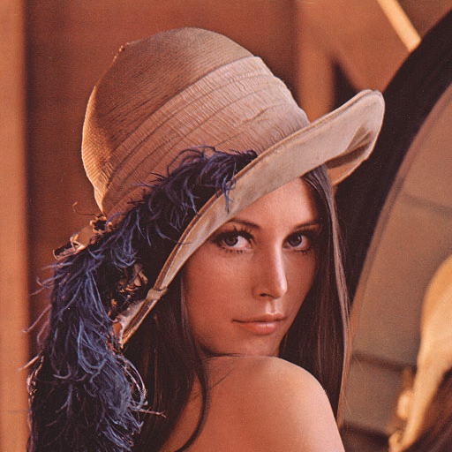




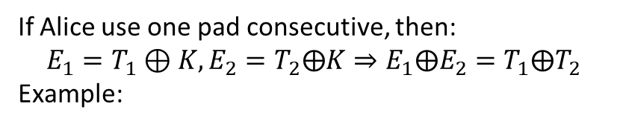



3. OTP protocol and its cons
If Alice use one pad consecutive, then:
$$E_{1}=T_{1}⊕K,E_{2}=T_{2}⨁K⇒E_{1}⨁E_{2}=T_{1}⨁T_{2}$$
Example:
$$K$$
$$T$$
$$E$$

Slide 5
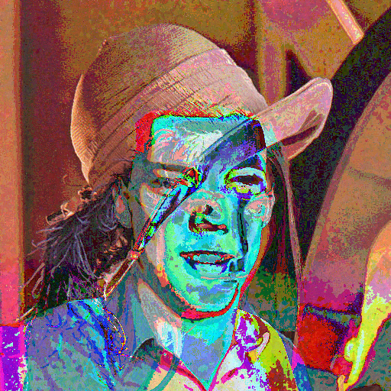






3. OTP protocol and its cons
$$⊕$$
$$⊕$$
$$⇒$$
$$K$$
$$T$$
$$E$$

Slide 6
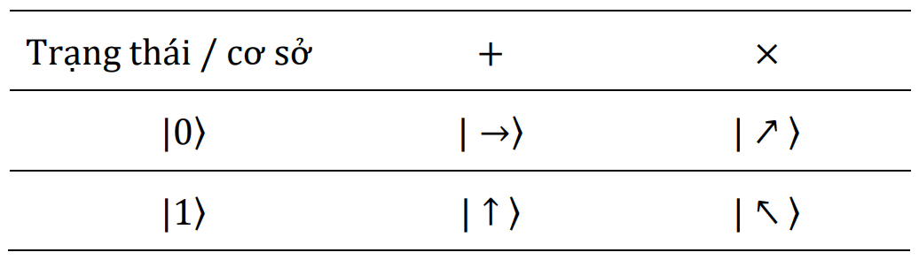
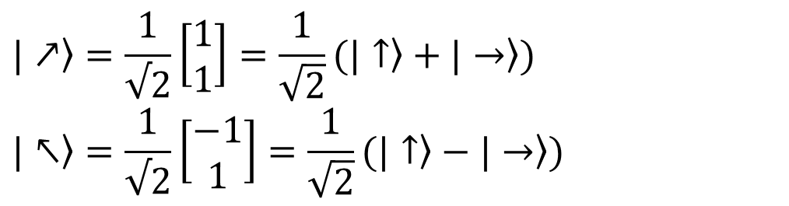
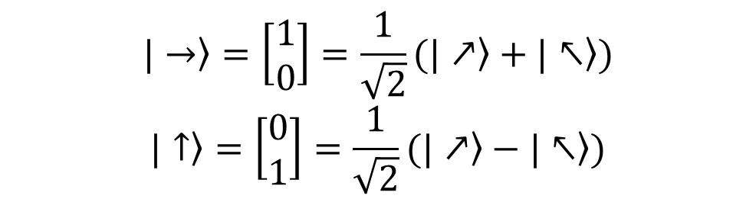
4. BB84 (Charles H. Bennett & Gilles Brassard)
$$\left.|→\right\rangle =\left[\begin{matrix}1 \\ 0\end{matrix}\right]=\frac{1}{\sqrt{2}}(\left.|↗\right\rangle +\left.|↖\right\rangle )$$
$$\left.|↑\right\rangle =\left[\begin{matrix}0 \\ 1\end{matrix}\right]=\frac{1}{\sqrt{2}}(\left.|↗\right\rangle −\left.|↖\right\rangle )$$
$$\left.|↗\right\rangle =\frac{1}{√2}\left[\begin{matrix}1 \\ 1\end{matrix}\right]=\frac{1}{\sqrt{2}}(\left.|↑\right\rangle +\left.|→\right\rangle )$$
$$\left.|↖\right\rangle =\frac{1}{√2}\left[\begin{matrix}−1 \\ 1\end{matrix}\right]=\frac{1}{\sqrt{2}}(\left.|↑\right\rangle −\left.|→\right\rangle )$$

Slide 7
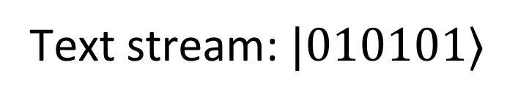
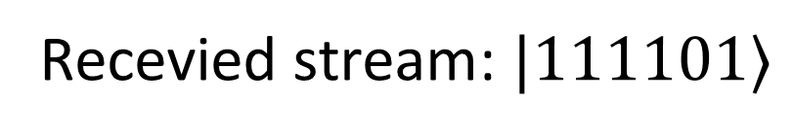
Encrypted stream
Text stream: $|010101⟩$
Recevied stream: $|111101⟩$

Slide 8
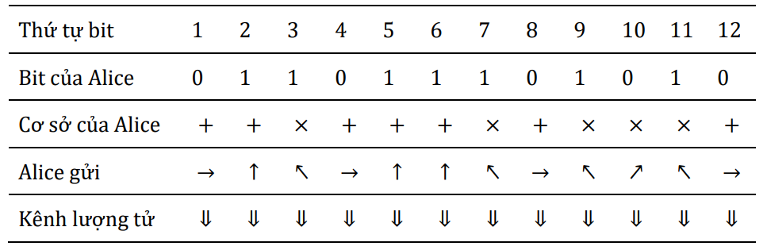
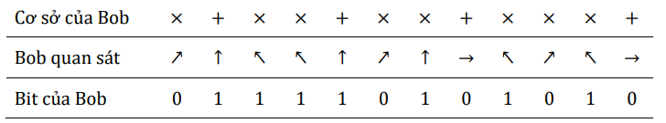

Slide 9
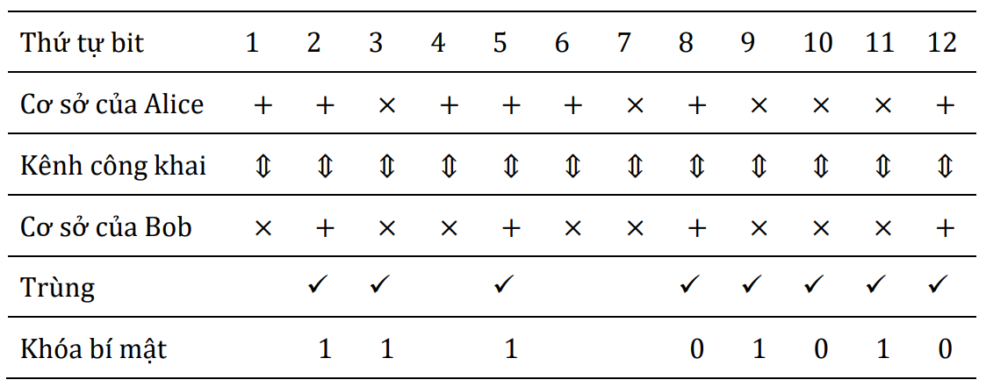

Slide 10
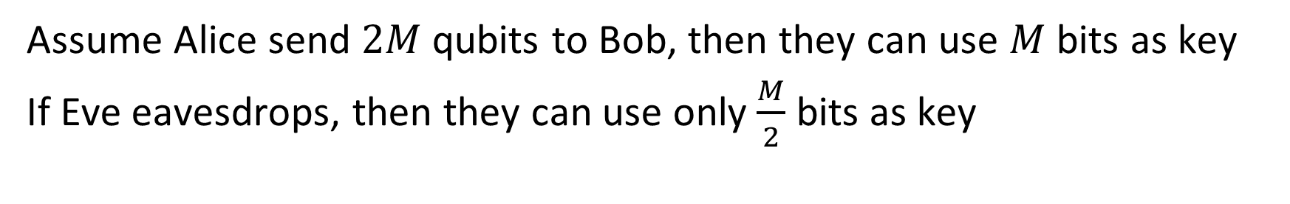
4. BB84 (Charles H. Bennett & Gilles Brassard)
Assume Alice send $2M$ qubits to Bob, then they can use $M$ bits as key
If Eve eavesdrops, then they can use only $\frac{M}{2}$ bits as key
x
Alice
Bob
Eve

Slide 11
